Slide 1


GitTorrent
The decentralized information manager from hell
Manas Pratim Biswas
Roll - 002011001025 UG - IV
Information Technology
Jadavpur University

Slide 2

Introduction

Slide 3
Looking Back

Slide 4
Federated Internet

Slide 5
Federated Internet
File sharing — FTP, HTTP
Chats — IRC, XMPP
Messaging — Email, Fidonet

Slide 6
Centralized Internet
File sharing — Dropbox, Google Drive
Chats — Slack, Discord
Messaging — Facebook, WhatsApp
Payments — PayPal
Code — GitHub, GitLab, BitBucket

Slide 7
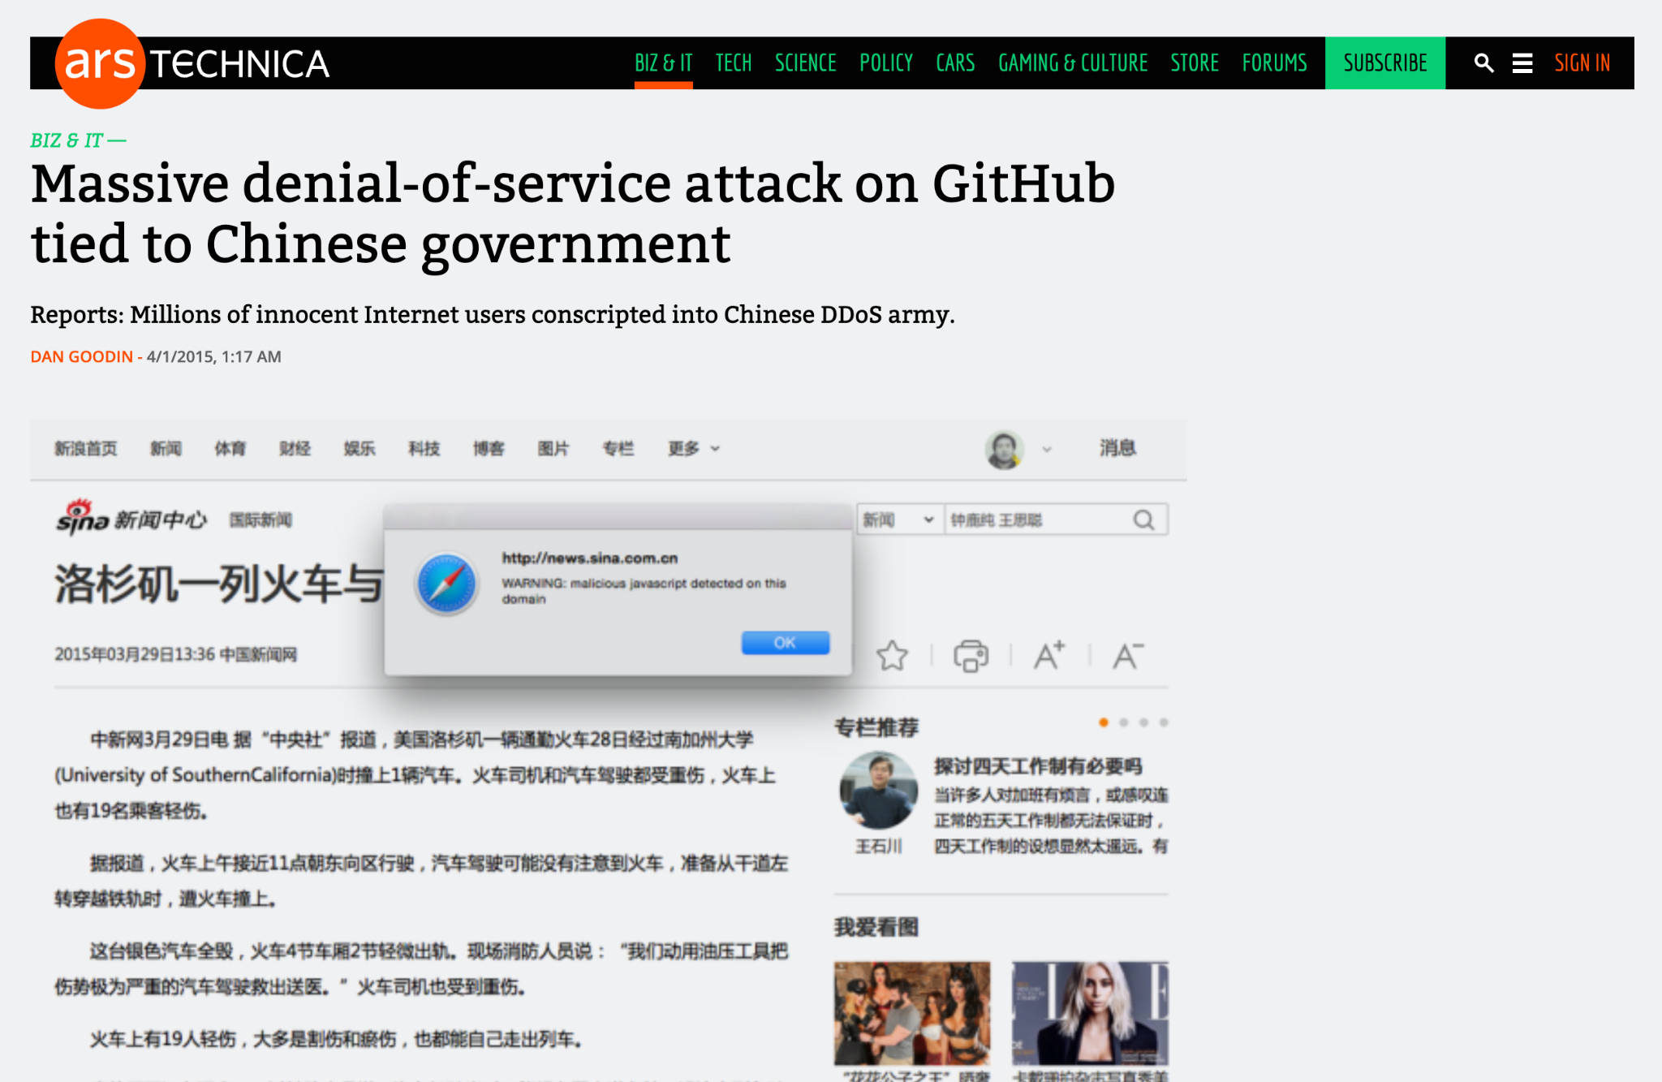
Demerits of Centralization
Data Leaks Censorship
Resilience and Availability Government Surveillance
https://arstechnica.com/information-technology/2015/03/massive-denial-of-service-attack-on-github-tied-to-chinese-government/

Slide 8

A New Hope

Slide 9
Peer-To-Peer
Distributed Network

Slide 10
Fundamentals
Peer-To-Peer communication
Decentralization of Control
High Resilience and Low Redundancy
Maintain a Distributed Ledger

Slide 11
Re-Decentralization
File sharing — BitTorrent, IPFS
Chats — Matrix
Messaging — GNU Ring, Tox
Payments — BitCoin, Ethereum
Code — Distributed Git => GitTorrent

Slide 12
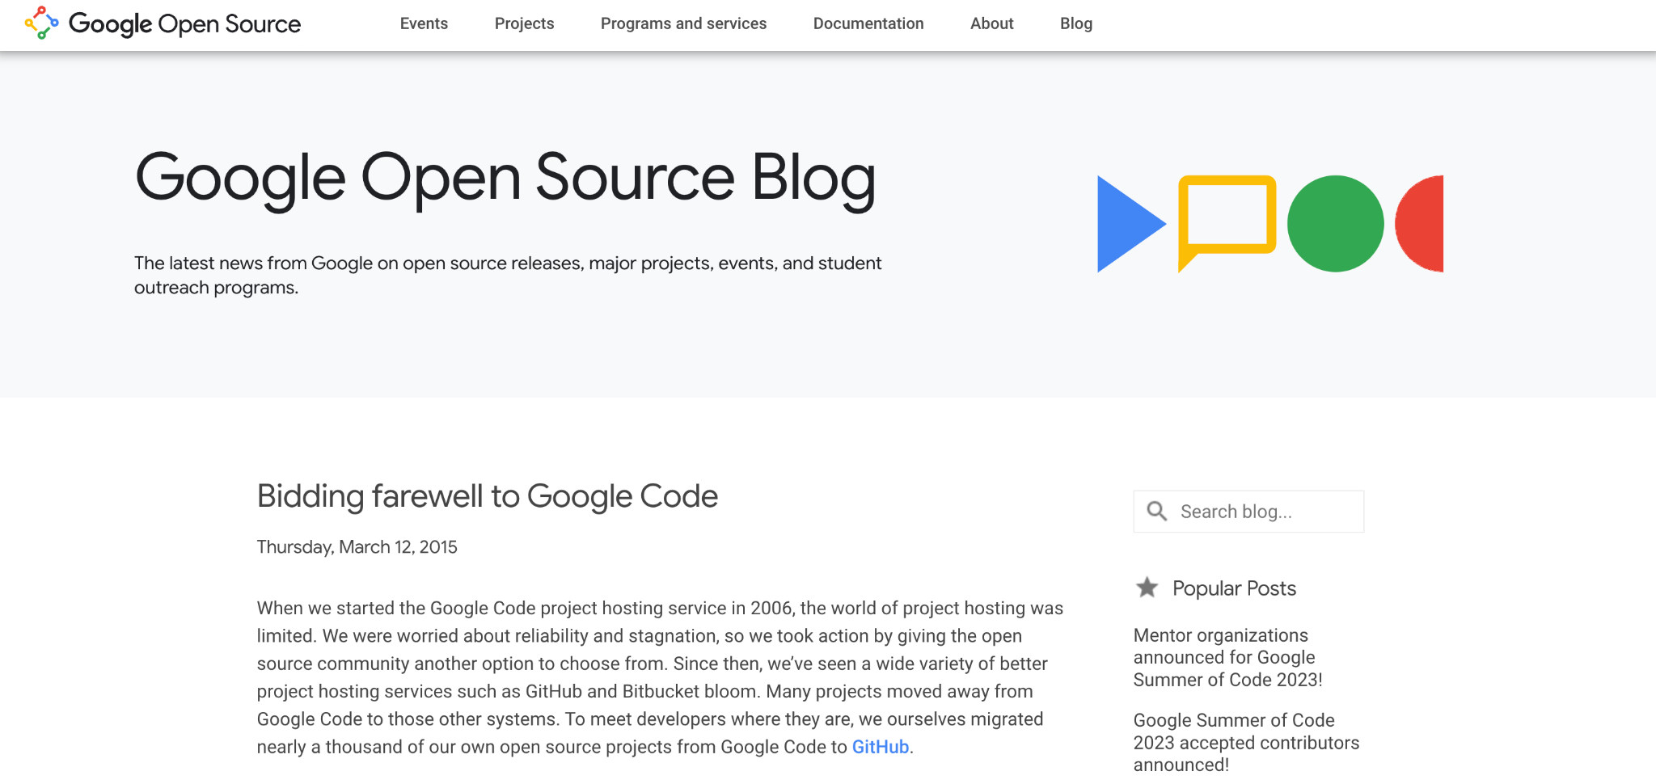
Why GitTorrent ?
https://opensource.googleblog.com/2015/03/farewell-to-google-code.html

Slide 13
Why GitTorrent ?
Practical Reasons
GitHub’s vulnerabilities and potential hacks/ DDoS threats
GitHub’s centralized control over open-source collaboration
https://mako.cc/writing/hill-free_tools.html

Slide 14
Why GitTorrent ?
Philosophical Reasons
Free softwares dependency on proprietary tools
Lack of control and modification options for users
https://mako.cc/writing/hill-free_tools.html

Slide 15
Why GitTorrent ?
Ironical Reason
Shifting from centralized protocols (CVS, Subversion) running on multiple servers to decentralized protocols (DVCS, Git) running on a centralized GitHub server
https://mako.cc/writing/hill-free_tools.html

Slide 16
Isn’t Git already Decentralized ?
Comparing Git to FTP, the lack of an index and the inability to turn clients into servers hinder the true decentralization of Git.
Unlike peer-to-peer protocols like BitTorrent, Git doesn't inherently provide visibility into where repositories are stored or enable direct communication between clients.

Slide 17
Isn’t Git already Decentralized ?
GitTorrent aims to address this limitation by introducing a decentralized approach, allowing users to locate and clone repositories without relying on a central server.

Slide 18
GitTorrenting a repository hosted on BitTorrent
1 git clone gittorrent://github.com/cjb/recursers
2 Cloning into 'recursers'...
3
4 Okay, we want to get: 5fbfea8de70ddc686dafdd24b690893f98eb9475
5
6 Adding swarm peer: 192.34.86.36:30000
7
8 Downloading git pack with infohash:
9d98510a9fee5d3f603e08dcb565f0675bd4b6a2
9
10 Receiving objects: 100% (47/47), 11.47 KiB | 0 bytes/s, done.
11 Resolving deltas: 100% (10/10), done.
12 Checking connectivity... done.

Slide 19

find the latest revision/commit
GitTorrenting a repository hosted on BitTorrent
run gittorrent protocol
git clone
git-remote-gittorrent
GitHub
commit: 5fbfea8de...
packfile of git repository
peer-to-peer network

Slide 20
GitTorrenting a repository hosted on BitTorrent
get_nodes('5fbfea8de70ddc686dafdd24b690893f98eb9475') = [192.34.86.36:30000, ...]
list of all peers or the peer set that
can seed that particular commit

Slide 21
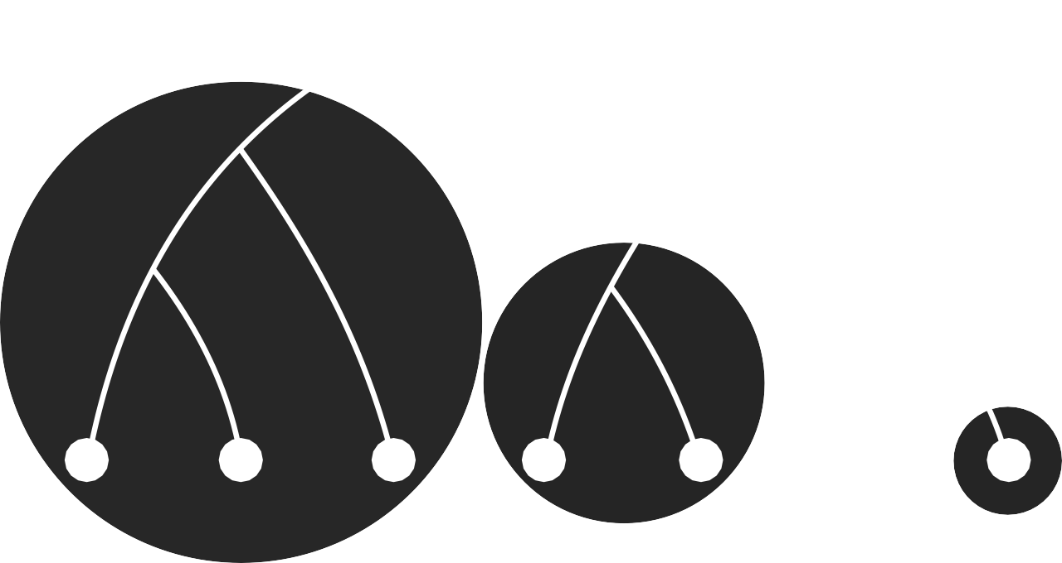
Kademlia Distributed Hash Table
1
1
10
0
10
0
10
0
1
000 001 010 100 101 110 111

Slide 22
Removing the GitHub Centralised Dependency
// Immutable key put hash(value) = put({ value: 'some data' }) // Mutable key put hash(key) = put({ value: 'some data', key: key, seq: n }) // Get value = get(hash)
each node maintains a
network-wide key-value store

Slide 23
GitTorrenting a new revision or commit
new commit as
a signed update
with a new seq no
update and redistribute the new commit
verify public key with
the hash table key

Slide 24
GitTorrenting a repository hosted on BitTorrent
run gittorrent client with a hex number that is the hash of author’s public key which is used as a mutable key on the distributed hash table
hash: 81e24205d4bac8496d3e13282c90ead5045f09ea
git-remote-gittorrent
peer-to-peer network
packfile of git repository

Slide 25
1 git clone gittorrent://81e24205d4bac8496d3e13282c90ead5045f09ea/recursers 2 3 Cloning into 'recursers'... 4 5 Mutable key 81e24205d4bac8496d3e13282c90ead5045f09ea returned: 6 name: Chris Ball 7 email: chris@printf.net 8 repositories: 9 recursers: 10 master: 5fbfea8de70ddc686dafdd24b690893f98eb9475 11 12 Okay, we want to get: 5fbfea8de70ddc686dafdd24b690893f98eb9475 13 14 Adding swarm peer: 192.34.86.36:30000 15 16 Downloading git pack with infohash: 9d98510a9fee5d3f603e08dcb565f0675bd4b6a2 17 18 Receiving objects: 100% (47/47), 11.47 KiB | 0 bytes/s, done. 19 Resolving deltas: 100% (10/10), done. 20 Checking connectivity... done.

Slide 26
Conclusion

Slide 27
A global BitTorrent swarm of Git objects
git clone https://github.com/cjb/foo
git clone gittorrent://github.com/cjb/foo
git clone gittorrent://81e24205d4bac8496d3e13282c90ead5045f09ea/foo

Slide 28
GitTorrent Limitations
Doesn’t implement GitHub Comments, Issues, Discussions
Doesn’t implement Pull Request and collaborative workflow
Seeders should be rewarded for being a part of network
DHTs support is limited

Slide 29
GitTorrent Future Work
Distributed revision control systems for bug tracking - Bugs Everywhere
Use IPFS (InterPlanetary File System) instead of BitTorrent swarm
https://ipfs.tech/
https://bugseverywhere.org/

Slide 30
References
https://blog.printf.net/articles/2015/05/29/announcing-gittorrent-a-decentralized-github/
https://github.com/cjb/GitTorrent
https://lwn.net/Articles/646628/
https://news.ycombinator.com/item?id=9625840

Slide 31
Thank you
https://github.com/sanam2405/seminar
Manas Pratim Biswas (@sanam2405)
Roll - 002011001025 UG - IV
Information Technology
Jadavpur University

Slide 32
Questions ?

Slide 33
Authentication Metrices
- False acceptanct rate.
- False rejection rate.
- Failure to enroll rate.
- Authentication time.

Slide 34
Authorization Metrices
- Access control effectiveness.
- Least privilege enforcement.
- Policy violations.
- Audit trail quality.

Slide 35
Applications to overcome the issues
- bcrypt.js package for password hashing.
- jsonwebtoken to maintain session.
- middleware to authorize user before accessing some
component.
- @react-oauth/google package for authenticating
an users through their valid credentials.

Slide 36
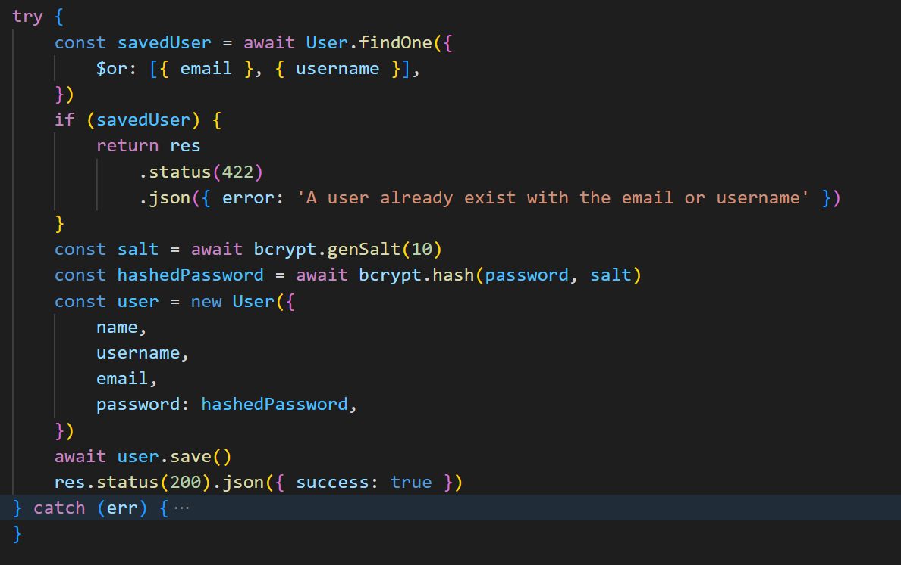
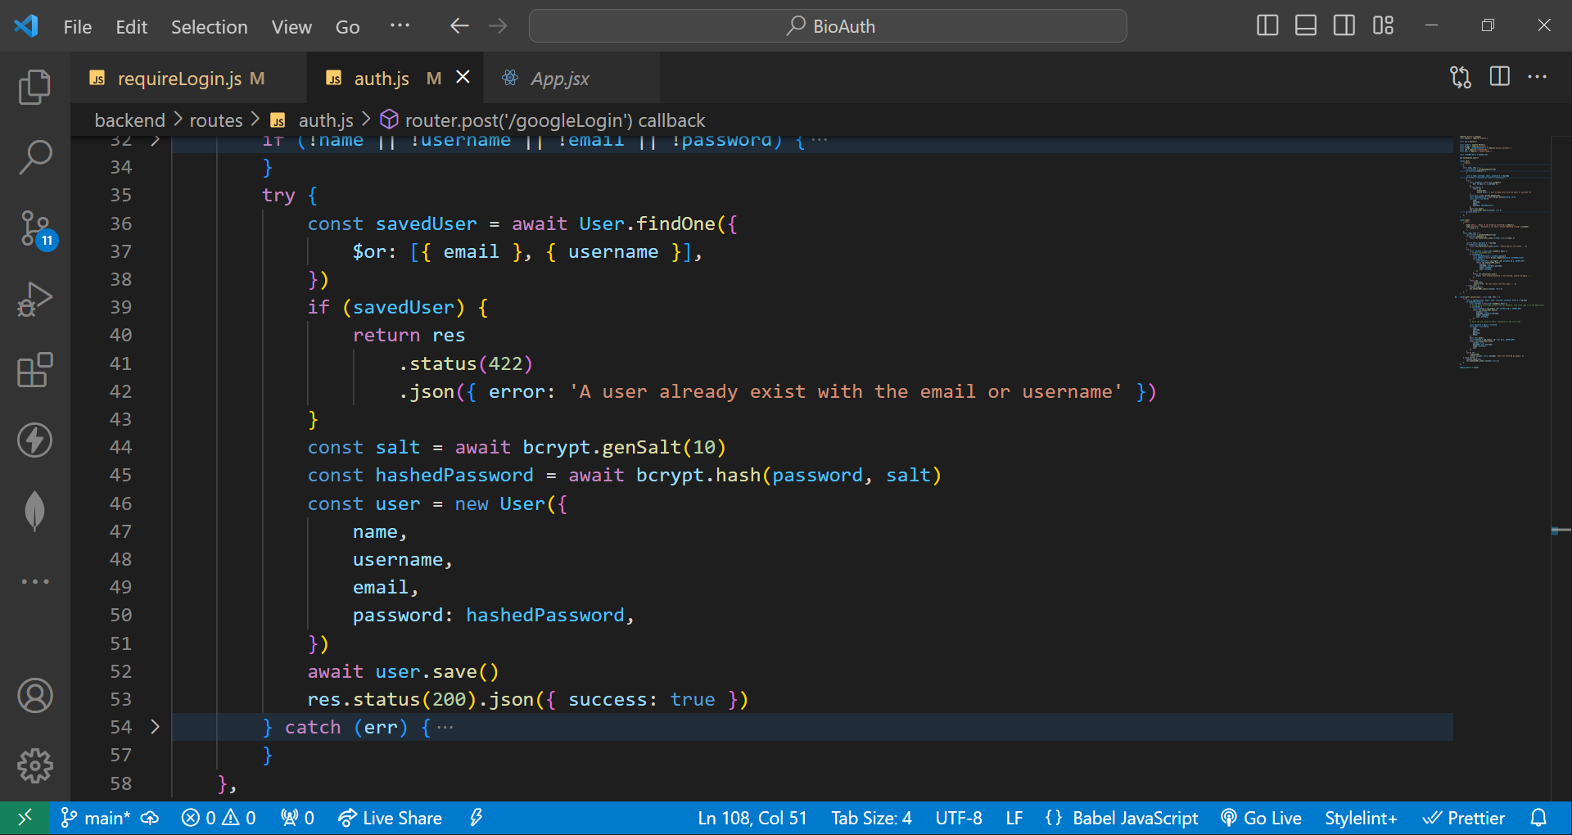
Applications to overcome the issues

Slide 37
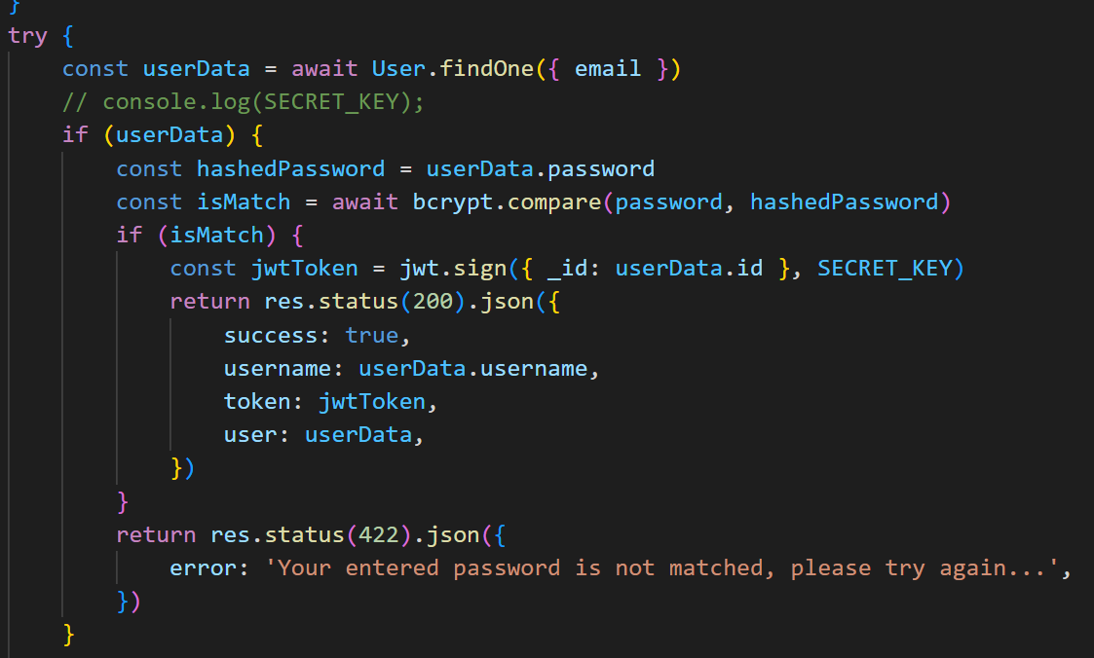
Applications to overcome the issues

Slide 38
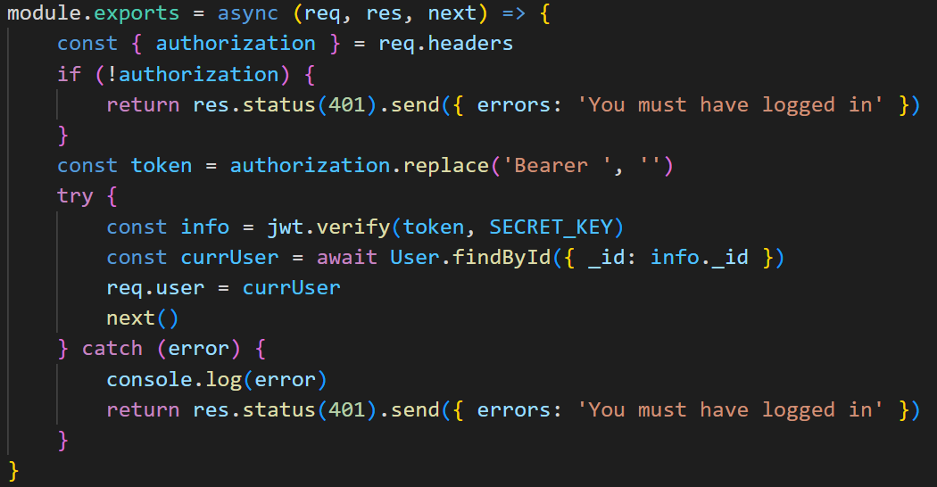
Applications to overcome the issues

Slide 39
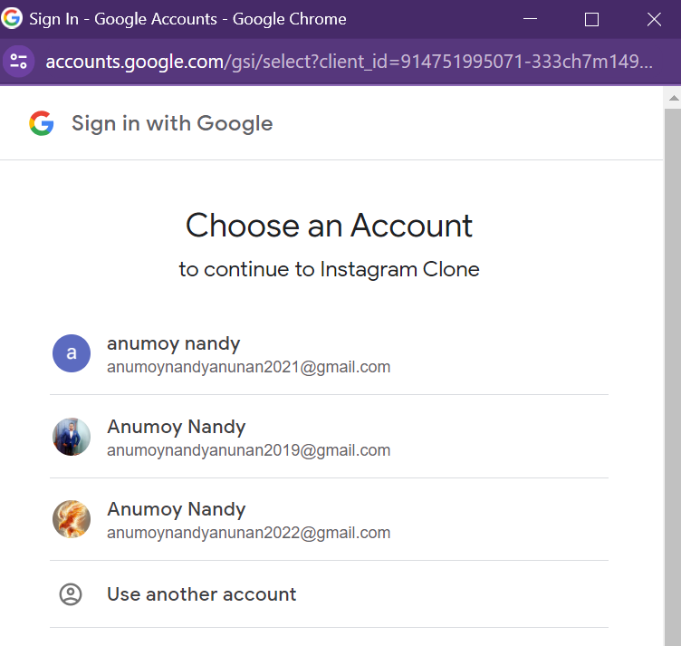
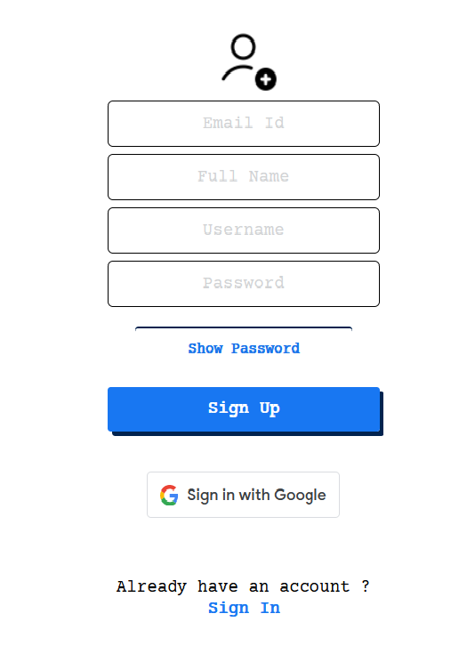
Applications to overcome the issues

Slide 40

Applications to overcome the issues

Slide 41
Applications to overcome the issues

Slide 42
Applications to overcome the issues

